Slide 1

Netflix Dataset Analysis
Arshiya Khan
Internship ID: INTERNSHIP_17546440516895be537820f
Student ID: APPLY_175569377868a5c2d267798

Slide 2

PROBLEM STATEMENT
Netflix is facing increasing competition from other OTT platforms like Amazon Prime, Disney+, Hotstar.
Huge content library makes it difficult to analyze trends without data-driven insights.
Need to understand:
How content is distributed between Movies & TV Shows
Which genres are most popular
Which countries contribute most content
Goal: Provide insights that help Netflix improve content strategy & recommendations.

Slide 3
Project Description
Dataset contains 7,789 records and 11 attributes (title, director, cast, release year, country, duration, type, etc.).
Conducted data preprocessing & cleaning (handled missing values, formatting).
Performed Exploratory Data Analysis (EDA):
Movies vs TV Shows distribution
Content added over years
Genre popularity trends
Country-wise contributions
Created visualizations for clear, professional insights.

Slide 4

WHO ARE THE END USERS?
Netflix Management & Content Strategy Team – to decide on future productions/acquisitions.
Marketing Team – to understand regional trends for targeted campaigns.
Data Analysts/Researchers – to explore OTT trends and compare with competitors.
Students & Interns – as a learning project in data analysis & visualization.

Slide 5

Technology Used
Programming Language: Python
Libraries and Tools:
- Pandas: Data preprocessing, cleaning, and analysis
- Matplotlib & Seaborn: Data visualization and graphical representation
- NumPy: Numerical computations and data manipulation
Development Platform: Jupyter Notebook
Dataset Source: Netflix Dataset (CSV file containing 7,789 records)

Slide 6
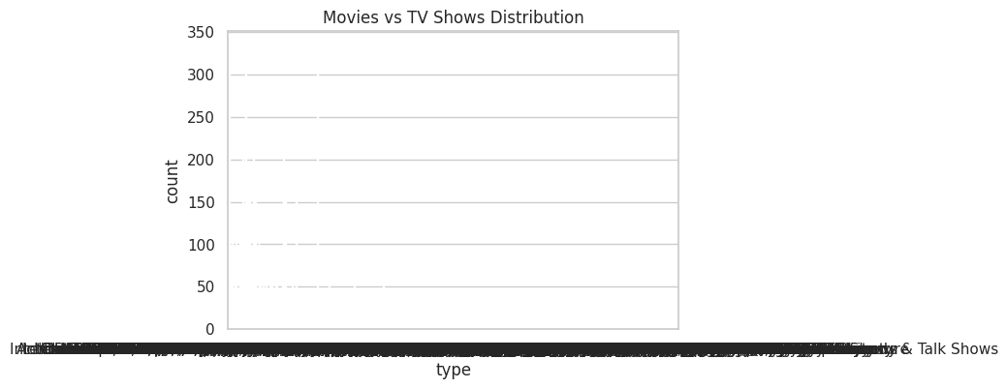
RESULTS1
[Add screen shots of your code or Chart(s) ]

Slide 7
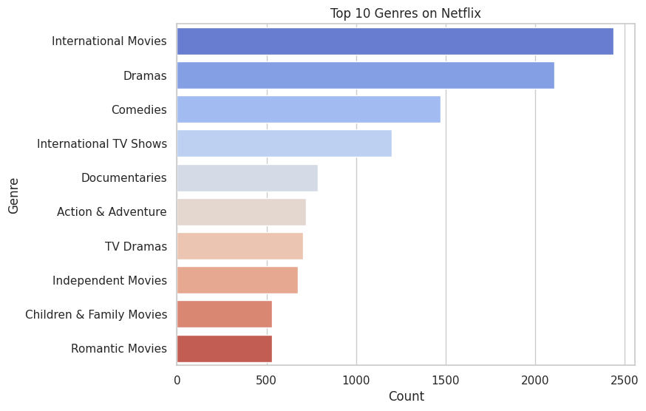
RESULTS2
[Add screen shots of your code or Chart(s) ]

Slide 8
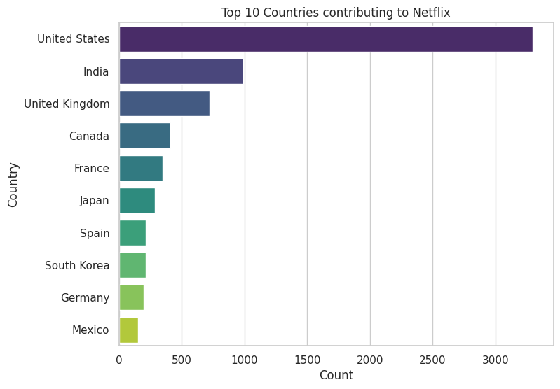
RESULTS3
[Add screen shots of your code or Chart(s) ]

Slide 9
GitHub repository
https://github.com/arshiyakhan1613/VOIS_AICTE_Oct2025_Major_Project_ARSHIYA_KHAN

Slide 10
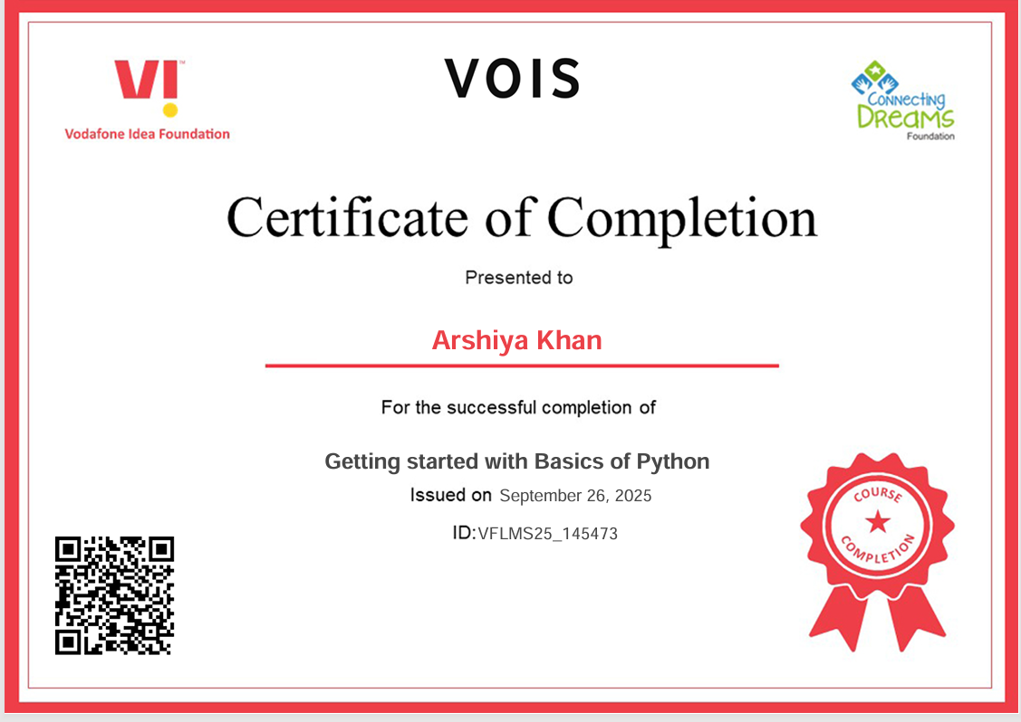
Getting started with Basics of Python Certificate

Slide 11
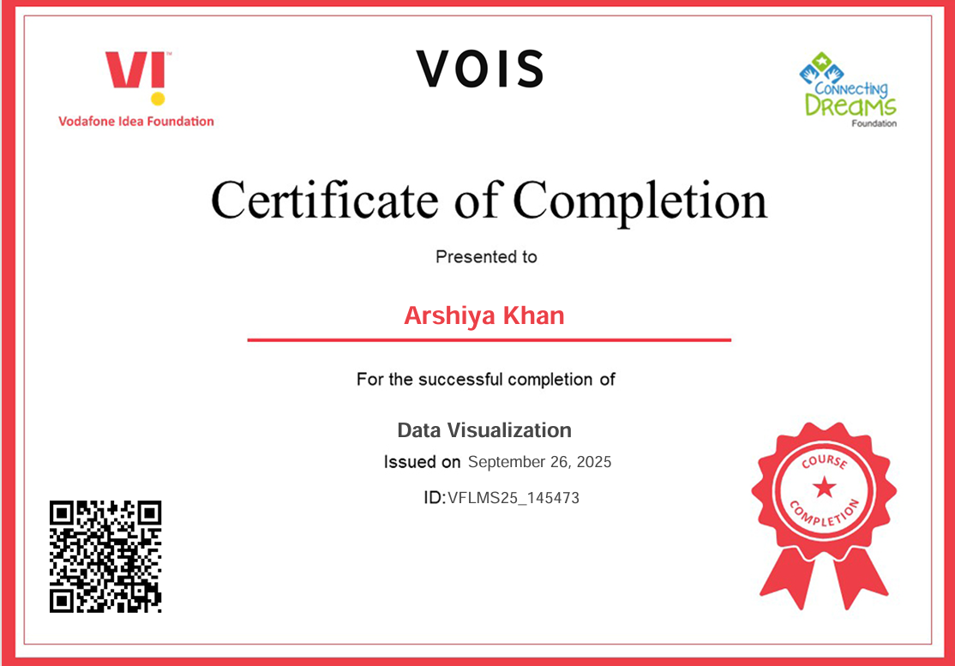
Data Visualization Certificate

Slide 12
Thank you
.
.

